Slide 1


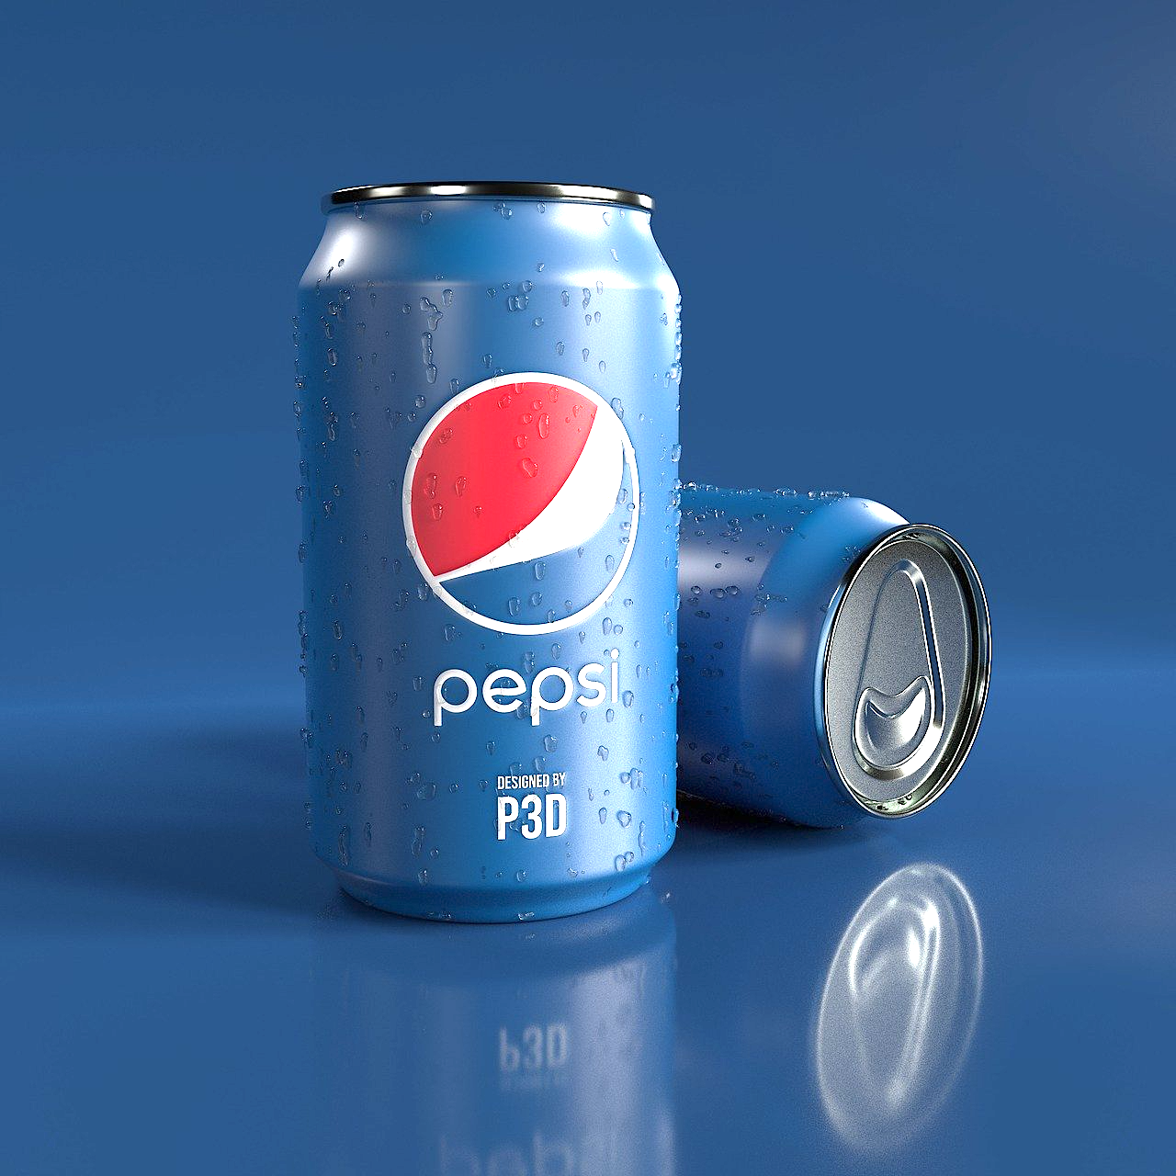

Equity Research on
American Airlines, Disney, and PepsiCo
Morgan Stanley & Columbia University 2nd Annual Summer Data Challenge
by Team D’accord
from Columbia University IEOR
August 2021
& Morgan Stanley

Slide 2
Team D’accord
Executive Summary
Objective
Sub-objectives
Components
Methodology
Highlights
Evaluate the performance of AAL, DIS, and PEP compared with S&P 500
To determine a company’s
stock performance
Absolute valuation
Discounted Cash Flow (DCF) Model
Relative valuation
P/E ratio & P/B ratio
AAL: Strongly affected by suppliers and competitions, AAL returns to neutral after merger in 2013
DIS: Outperformed the market, high intrinsic value
PEP: Underperformed the market, but its strong financial performance raised its value
Market Research
To identify noteworthy information that may have contributed to the stock’s volatility
Hypothesis list of features in market, industry, and company level
Analyze the trends and changes with features
Trends & changes in stock prices
To simulate stock prices and identify important features with modeling
Hypothesis
Stock and market metrics
Firm’s published data
News
Social Media (tweets)
Modeling Techniques
LSTM
NLP –Sentiment Analysis
Complex NN
Highlights from models
Market data reflects trends
Financial data narrows errors
News adds daily details
Implications of models
The model provides insights on whether the target share price is over/under/neutral valued relative to its competitor share price
The model provides insights on whether the target share price relative to S&P 500 is over/under/neutral valued after COVID-19
Evaluation on models
Among different linear, tree-based and neural network models, neural network performs best and our model has least error
To evaluate results and
robustness of the models
Modeling
Analysis on Competitors
Train our model with target stock and predict the competitor stock
Analysis on COVID-19
train our model with data before the COVID-19 and predict the price after the COVID-19
To evaluate the models’ implication on real-world problems
Robustness Testing
Predictive accurateness among different models
Prediction Evaluation
Train/test evaluation with MAPE, R square
1

Slide 3
AAL has a neutral performance and is more volatile than the market due to uncertainty about suppliers, travel policies and fierce competitions
Market Research: American Airlines (AAL)
Team D’accord
1
AAL benefits from merger but calms down in intensive completions
2018/6: AAL greatly changed international networks due to increasing fuel price and financial crisis
Monthly Average Share Price Indexed to 2010-January (%)
2016/7: AAL firstly launched Premium Economy seating on international flights.
2019/6: AAL impaired revenue by grounded Boeing 737 MAX for 8 months
2021/4: AAL reported a full-year net loss of around 9 billion under COVID-19
AAL
S&P 500
News information
Market information
Financial information
2013/12: AMR and US Airways got merged.
2020/1: Airlines temporarily suspended flights due to COVID-19
2015/3: AAL was added to S&P 500 index
AAL
+ 320.09%
2011/11: AMR filed for bankruptcy protection
2018/3: Price war triggered fierce competition
S&P 500
+ 309.29%
2016/6: Terrorism fears
2014/6: Increased tension in Iraq raise oil price
2021/1: As people getting vaccinations, traveling got recovered
2
AAL was under-valued before merger in 2014 and became neutral
3
Compared to industry, AAL has neutral intrinsic value
DCF Valuation
P/B Ratio (%)
P/B Ratio
(%)
P/E Ratio
Share Price ($)
Share Price
DCF
AAL
Comparable Companies
The gap between AAL’s price and DCF is narrowed after 2014, with value from under to neutral
AAL’s P/B ratio fluctuates violently, reaching extreme high in 2013-2015 and extreme low in 2018-2020, while P/E ratio has periodic fluctuation, which reflects under-valuation before 2015 and neutral afterwards
Source: Yahoo Finance; Financial Modelling Prep; Macrotrends; Desk research; CNN; AAL
Note: ratios of comparable companies are the medians of LUV, DAL, UAL, ALK, JBLU, ULCC, ALGT, SAVE, SKYW
2
Notes:
Final 1

Slide 4
DIS Performs Stronger than the Market Especially during the Pandemic
Market Research: The Walt Disney Co. (DIS)
Team D’accord
1
Constant expansion of business scope makes DIS robust
2015/11/5: 2015 Disney delivered the highest revenue, net income , and adjusted EPS in the Company’s history.
2017/8: Disney intended to pull all its movies from Netflix.
2018/10: acquisition of BAMTech renamed as Disney Streaming Services.
2019/04: completion of the acquisition of 21st Century Fox.
2021: strong performance by Disney+ with high demand in streaming.
Monthly Average Share Price Indexed to 2010-January (%)
News information
DIS
S&P 500
Market information
DIS
+ 477.42%
Financial information
2015/08/4: record net income and diluted EPS up 13% in 2015Q3
S&P 500
+ 309.29%
2013/06: ‘Monsters University’ released
2019/11: Disney+ was launched
2011/8: S&P's downgraded the US’s credit rating to ‘AA+’
2015/07: Greece’s unraveling debt negotiations placed the European country on the brink of fiscal collapse.
2015/12: WIT Crude price declined by 10% in a month
2018/8: U.S. corporates had posted better-than-expected earnings results.
2020/9: Another lockdown in the U.S. U.K’s infection rate reached 50,000 per day.
2
DIS has been under-valued since 2020
3
Compared to industry, DIS has a relatively high intrinsic value
DCF Valuation
P/B Ratio (%)
P/B Ratio
(%)
P/E Ratio
Share Price ($)
Share Price
DCF
DIS
Comparable Companies
DIS has a relatively low P/B and P/E ratio which shows great potential. After the COVID-19 (2020), DIS performs much better than the industry average value. The reason behind is the streaming business has developed faster than expected amid the pandemic
DIS is neutrally valued before 2020 and undervalued since 2020 under DCF model
Source: Yahoo Finance; Financial Modelling Prep; Macrotrends; Desk research
Note: ratios of comparable companies are the medians of CMSCA, NFLX, FB, AMC, WWE
3
Notes:
Industry: COKE, KDP, MNST, FIZZ, KO

Slide 5
PEP underperforms market, but its strong financial performance raised its value and share price
Market Research: PepsiCo (PEP)
Team D’accord
1
PEP is in a good financial situation, leading to rises in share price after financial reports are released
2018/2: Insane Fall (over 40%) of Dow since President Donald Trump’s election.
2018/5/25: PEP announced that it would acquire baked fruit and vegetable snack maker Bare Foods
2020/3: The S&P 500 index dropped 34%, which was part of a worldwide recession caused by the COVID-19 pandemic.
2020/10: PEP came out with quarterly earnings of $1.66 per share, beating the estimates.
Monthly Average Share Price Indexed to 2010-January (%)
News information
S&P 500
+ 309.29%
PEP
S&P 500
Market information
Financial information
2016/11: PepsiCo Announced Definitive Agreement to Acquire KeVita, a Leader in Fermented Probiotic Beverages
2011/2: Center for Environmental Health stated that the caramel pigments of Pepsi and Coca-Cola contained a carcinogen 4-MEI
2011/5-2011/10: S&P 500 entered a short-lived bear market between 2 May 2011 and 04 October 2011 with a decline of 21.58%.
2014/4: PEP’s income rose 13% in the first quarter
2015/8: Dow Jones fell 1300 points from August 18-21
PEP
+ 151.5%
2018/7: PEP took century-old Madison Square Garden contract from Coca-Cola
2021/4: PEP Q1 earnings and revenue surpassed estimates
2
PepsiCo has been undervalued since 2010
3
Compared to industry, PepsiCo has a relatively high performance
DCF Valuation
P/B Ratio (%)
P/B Ratio
(%)
P/E Ratio
Share Price ($)
Share Price
DCF
PEP
Comparable Companies
The gap between its intrinsic value and share price increases between 2017 to 2018 because because growth of S&P 500 resulted in a higher discounted rate
Since 2014, PepsiCo has a relatively high P/B ratio and a relatively low P/E ratio, showing a very high ROE. The high ROE comes from its diverse products and frequent M&A
Source: Yahoo Finance; Financial Modelling Prep; Macrotrends; Desk research
Note: ratios of comparable companies are the medians of KDP, MNST, FIZZ, KO
4
Notes:
Industry: COKE, KDP, MNST, FIZZ, KO

Slide 6
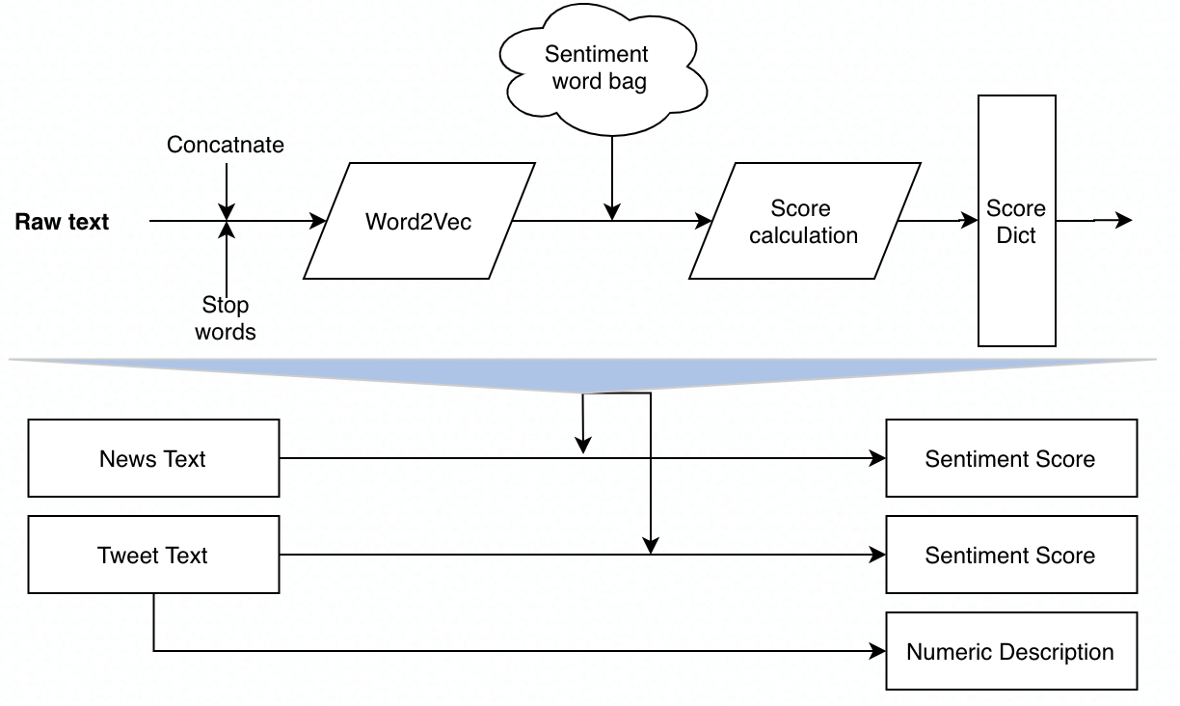
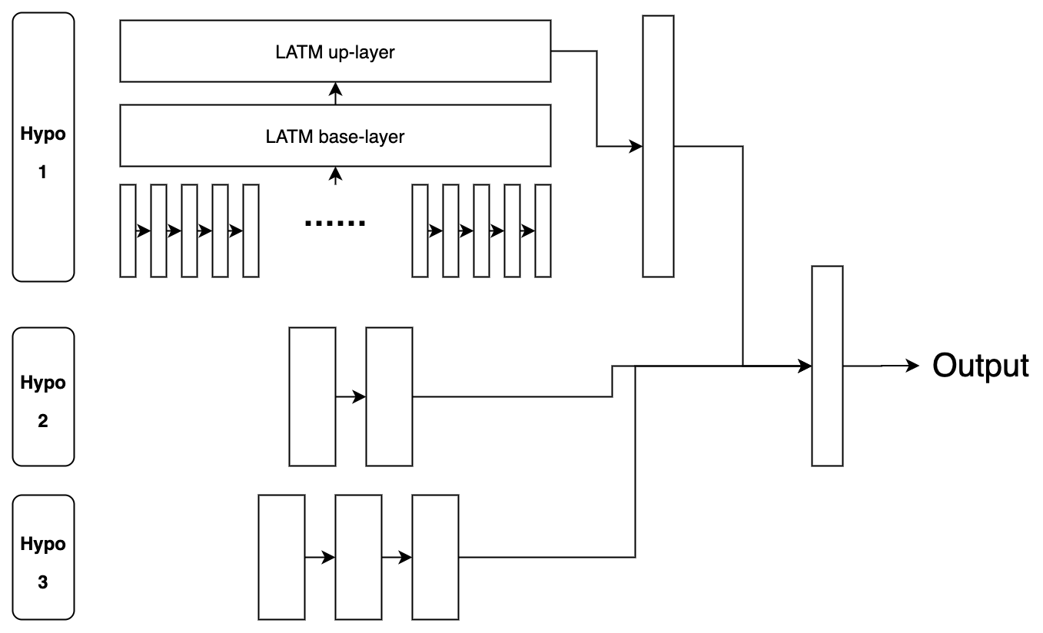
Modeling: Logics & Structure → Result Analysis → Applications
Team D’accord
Hypothesis, Features, and Models
Hypothesis
Hypothesis 3: investors’ decisions can be affected by the information from news and social media, so stock price is affected by public sentiment
NLP
Text sentiment analysis technique is applied to extract information from news and tweets.
Sentiment tags include: positive, negative, anger, fear, joy, sadness, surprise, etc.
In addition to sentiment score, numerical features are computed, such as number of likes.
Hypothesis 2: share price is affected by not only factors from the stock market, but also the company’s financial performance
Hypothesis 1: share price can be captured by the information from stock market
Information
Resources
Stock Market
Financial Performance
Public Sentiment
The model is a complex neural network, with different modules represent different component for the three hypotheses.
Self-related stock info : Volume
Market-related info: S&P 500 price
Quarterly financial indicators: Revenue, gross profit, net income
News
Social Media: Twitter
LSTM
Features
Two-layer LSTM for processing time series data from stock market.
NLP
ANN for processing covariates of financial information.
Model 1
(Daily)
Model 2
(Quarterly)
Model 3
(Daily)
Model
Support
ANN for processing sentiment score
Data Analysis
5

Slide 7
Share price of AAL is sensitive to public sentiments and financial data
Modeling: Logics & Structure → Result Analysis (AAL) → Applications
Team D’accord
1
Stock Market
Training MSE
2020.7.20
Testing MSE
1
Model without Tweets
2020.12.11
Actual
Prediction
12.40
77.96
Technical analysis captures most of historical general trends and predicts with upwards direction in test set which is consistent with facts, but it fails to fit daily details for lack of daily news.
Predictions at ① and ② are flatter than reality because S&P500 increased in stable paces and AAL’s volumes were moving around a constant
Test part: Predictions are more optimistic than real recovery in post-COVID because AAL’s volumes have sharply increased 5-10 times since 2020.1, caused by crude oil recovery.
6.74
17.80
1
2
1
2
2
Stock Market + Financial Statements
2
Model with Tweets
1
After adding financial data, model with both techniques and fundaments shows better training MSE. Because financial data is released quarterly, it does not improve daily predicts much.
Financial reports were released at ① (2015.3) and ② (2016.6), with positive and negative operational data respectively, giving apparent improvements there
More pessimistic predictions at ③ (2018) are raised by great drop of equities in 2018
Test part: Report of 2021.3 repressed post-COVID predictions with recovery signals and model’s smooth upwards trend fits facts well.
2
3
11.47
5.15
8.25
10.91
+7.50%
+93.4%
1
2
-22.5%
+38.7%
3
Stock Market + Financial Statements + News
With sentiments added, where news reflects some daily information, model shows even better training MSE with more fluctuations.
Although AAL was added to S&P 500 at ① (2015.3), its discontinuousness with US Airways had stronger impacts
Facing terrorism at ② (2016.6), AAL took actions to adapt new policies, which makes predictions more conservative
Fits after 2018 (③) is much better than before because CNN Business, the news resource we scraped from, faced digital transformations, and some history news was missing
Test part: Frequent news after 2020 makes post-COVID predictions volatile with increasing trends.
Twitter gives more fluctuations for smaller time granularities and fits details, especially turning points better for timeliness.
Grounded Boeing 737 MAX at ② (2019.6) increased complaints. Predictions with tweets are over-valued because AAL’s PR actions generated positive public opinions
Twitter model fits better at ① (2018.10) when AAL greatly modified networks, whose information could be reflected by tweets with customer satisfactions
Test part: Twitter reduces testing MSE with sharper growth because growing vaccinated population gets optimistic about summer travels.
1
3
13.35
4.56
2
-16.4%
+11.5%
Note: left part analyzes data from 2013; right part (including Tweets) analyzes data from 2017
6

Slide 8
Share price of DIS is sensitive to the public sentiment and financial data has unstable effect on prediction
Modeling: Logics & Structure → Result Analysis (DIS) → Applications
Team D’accord
1
Stock Market
Training MSE
2020.7.20
Testing MSE
1
Model without Tweets
2020.12.11
Actual
Prediction
In general, Disney and the overall market have very similar trends before 2020. Thus, our model can catch most of the volatilities of DIS.
① In Dec 2018 , Retail’s steep decline comes ahead of the holiday shopping season caused a downturn of the stock market.
In the later half of 2020, after the first round of outbreak of the pandemic, DIS had a surge above the market average level resulted from
② The subscriber of Disney+ reached 100 million. Disney also expanded multiyear sports rights deals for ESPN and ESPN+. That makes DIS a good bet.
This info is not available in the market statistics which cause the model’s bad fit. Testing Part: Predictions are more negative than the actual value.
1
1
2
2
22.78
1257.12
10.22
180.92
2
Stock Market + Financial Statements
2
Model with Tweets
2
The feature of financial data in the model enables it to better fit actual prices at earnings release days.
① 2015/11/5 : Disney’s 2015 Fiscal Full Year delivered the highest revenue net income and adjusted EPS in the Company’s history.
Financial data has a negative effect on the model after ② 2020/02.
COVID-19 has significant impact at the Disney Parks, Experiences and Products segment, the revenue reduced 37% in 2020 and another 49% in the first half of 2021. However, there is market confidence in the strong performance of Disney’s streaming service.
Testing Part: Prediction is contrary to the actual trend after ② 2020/02
1
1
2
16.00
2513.56
13.54
55.66
+29.8%
+99.9%
-32.5%
+69.2%
3
Stock Market + Financial Statements + News
By adding public sentiment data, the overall fitting effect of the model has been significantly improved both before and after the pandemic outbreak.
We see better fitting result when company-related news are likely to generate public opinion:
① 2017/08 Disney announced it intends to pull all its movies from Netflix.
② Disney’s strong performance in streaming service Disney+ and ESPN+.
Testing Part: Although the optimization effect is partially offset by the influence of financial data, we can still see that model3 performs better than model1 and model2 on the training set.
Twitter data is scraped by day, the inclusion makes the model more sensitive to the public opinion.
From the chart, the prediction value becomes more volatile after adding twitter data ①. Limited to the number of tweets we can get, the data contains more noise when corporate news is not being followed by plenty of Twitter users. This caused an increase in MSE.
But when major events occur ② , Twitter data can lead to better fit of the model with unusual fluctuations.
Testing Part: By adding twitter data, the model has a generally better fitting effect after 2021/01.
2
1
13.86
1216.87
+39.2%
+3.2%
Note: left part analyzes data from 2013; right part (including Tweets) analyzes data from 2017
7

Slide 9
Share price of PEP is sensitive to the stock market and financial performance but not affected by the sentiments in social media
Modeling: Logics & Structure → Result Analysis (PEP) → Applications
Team D’accord
1
Stock Market
Training MSE
2020.7.20
Testing MSE
1
Model without Tweets
2020.12.11
Actual
Prediction
The information from the stock market can explain most volatility of PEP, and the performance of the overall stock market can be well reflected in the share price.
The insane fall of the stock market in 2018/2 caused a slump in share price, indicating that the stock market is undervalued. The predicted price is higher than the actual price at ② confirms the undervaluation of the stock market
Testing part: The predicted value has been rising, which is not consistent with the actual. This is because the stock market has been performing well after August 2020, indicating that non-market factors are affecting the share price.
2
1
1
19.78
26.70
12.32
36.65
2
Stock Market + Financial Statements
2
Model with Tweets
Financial performance can affect the share price directly or through the gap between public expectations and the actual situation.
From Feb to Aug 2015 (①), the actual price was lower than predicted, indicating that PEP could not meet the market expectation. This can be demonstrated by the fact the DCF value is lower than the share price in 2015 Q1 and Q2 in the Market Research part. However, after adding the financial information, the model narrowed the gap between the predicted price and the actual price because the company's earnings and income declined in this period, leading to a weak performance of its share price
Testing part: The predicted price is closer to the actual because financial information adjusted the sharp rise in the stock market.
2
1
1
14.78
53.59
3
18.08
19.03
-8.6%
-28.7%
+20.0%
+46.2%
3
Stock Market + Financial Statements + News
News affects the share price by influencing the public sentiment and expectations of the company. In this model, news increased the volatility of the predicted line.
The model performs better in May 2018 (③) when the predicted value becomes lower and closer to the actual price. This is because that PepsiCo announced that it would acquire fruit and veggie snack maker Bare Foods, which is not accepted by the public
Testing part: In Mar 2021, PEP has been named top plastic polluters for three years. The negative news enables the predicted price to be much closer to the lowest point of the actual price.
After adding the sentimental information from Tweets, errors become larger, indicating that the sentiment on social media cannot influence the share price of PEP.
In May 2018 (①), the announcement of Pepsi Generation campaign, the launch of its football fashion collection, and the sponsor for UEFA Champions League Final Opening Ceremony allowed PEP to receive good reviews on social media, leading a high predicted price. However, the predicted price was far from the actual price, which demonstrated that the information on social media can not be inflected in the share price
3
16.73
23.03
-7.5%
+21.0%
Note: left part analyzes data from 2013; right part (including Tweets) analyzes data from 2017
8

Slide 10
Modeling: Results → Testing and Evaluation → Applications
Team D’accord
Evaluate Impacts of the Model
Applying the Models to Competitors
Analyzing Impacts of COVID-19 with the Models
The model is trained with target stock and used to predict the competitor’s stock to analyze the relative under/over/neural share price performance compared with competitors.
Higher prediction value indicates higher performance over the competitor.
The model is trained with data before the COVID-19 and used to predict the price after the COVID-19 to analyze the relative relative under/over/neural share price performance compared to S&P 500.
Higher prediction value indicates higher performance over S&P 500 compared with time before the COVID-19.
AAL
AAL vs. UAL (United Airlines)
Actual
Prediction
AAL
AAL undervalued after COVID-19
Actual
Prediction
① shows before 2017, AAL is slightly overvalued compared to its competitor UAL .
② shows after 2017 and before 2020, AAL is seriously undervalued compared to its competitor UAL.
③ shows after 2020, AAL is still undervalued than UAL but the gap narrows.
Airline industry is hardly damaged by the pandemic and AAL is seriously undervalued relative to S&P 500 before COVID-19 than before COVID-19.
However, the gap has been decreasing as time goes by.
3
2
1
DIS
DIS vs. CMSCA (Comcast Operation)
DIS
DIS overvalued after COVID-19
① shows before 2017, DIS is overvalued compared to its competitor CMSCA .
② shows after 2017 and before 2020, DIS is is almost at the same level of performance as CMSCA.
③ shows after 2020, DIS is obviously undervalued in terms of CMSCA price.
During the COVID-19, Disney’s stock price was first undervalued and then overvalued after 2020/11 relative to S&P 500.
2020/11 is the time when DIS’s price and Disney+’s subscriber come to a rapid growth period.
3
2
1
PEP
PEP vs. KO (Coca-Cola Co)
PEP
PEP neutralvalued after COVID-19
① shows before 2020, PEP is almost at the same level of performance as KO.
② shows after 2020, PEP became overvalued compared to its competitor KO.
Generally, PEP shows higher performance than KO.
PEP overperformed during COVID-19 because of its strong snack business and countercyclically industrial character
With recovery of the epidemic, its advantages is no longer obvious, so PEP returned to it previous state.
1
2
9
Notes:
Final 3

Slide 11
Recommendations
Market Research → Modelling → Recommendations
Team D’accord
Findings
Recommendations
Stocks
AAL: Strongly affected by suppliers and competitions, neutrally valued after merger in 2013.
DIS: Outperformed the market, high intrinsic value.
PEP: Underperformed the market, strong financial performance.
Stocks
AAL: AAL’s higher volatility is a projection of airline industry, which is constrained by suppliers and customers. AAL would rebound in post-COVID recovery, but not in long-term period.
DIS: All parks are now open, Disney cruises are set to resume soon. And Disney+ continues to offer hit shows. With direct-to-consumer revenue up 59% to $4 billion, DIS is now a compelling stock for investors' watchlists.
PEP: PEP is financially stable and countercyclical, but it usually underperforms the market because of its low risk. Thus, PEP can be considered in economic recessions.
Modelling
Stock market, financial statements, news and Twitter with smaller time granularity support better fits.
AAL: News and Twitter capture turning points as supplementary of numbers
DIS: Financial data fills in details, and news and Twitter have stronger impact to stock price
PEP: Stock market gives enough information, but Twitter makes little improvements
Modelling
Financial metrics and sentiments can greatly improve model performance, especially social media data, which reflects public opinions.
Although neural network model shows best performance among all ML models, it has space for improvements.
It is highly recommended to rather use our model to validate different hypothesis and conduct comparison analysis as showed in this project than simply predict price.
For more precise prediction, more features need to be involved.
10

Slide 12





Appendix: Company → Modeling
Team D’accord
Appendix: AAL
1
AAL is strongly affected by its suppliers of fuels and aircrafts.
2
Porter’s Industry Analysis
Positive
Negative
1
Monthly Average Share Prices
AAL
WTI (Crude Oil)
BA (Boeing)
Nature Impact: COVID-19 raised 43 bankruptcies
Fierce Competition: Top 10 cover 85% market size
Stable Customer: Airlines find specific segments
Correlation | WTI (Crude Oil) | BA (Boeing) | AAL
WTI (Crude Oil) | 1 | - | -
BA (Boeing) | -0.42 | 1 | -
AAL | -0.43 | 0.54 | 1
Rivalry
Fuel & Aircraft: Market sets fuel price; Boeing builds aircrafts
Labor: Labor unions train employees
Air Space: Governments build legal terms
Supplier
Buyer
Platform: Algorithm sets optimal prices
Customer: Travel less when prices increase
2
Correlations Between Share Prices
In ①, from past 10-year data, Boeing and AAL are negatively correlated with crude oil, while Boeing and AAL have positive correlation.
In ②, before merger, correlations converge to 0 and then grow up over time.
AAL is highly correlated with Boeing and crude oil in positive relationships.
WTI vs BA
AAL vs WTI
BA vs AAL
Capital: Huge investments for operation
Resource: Customers, airports, alliances…
Regulation: Governments requires safety licenses
Entrant
Substitute
Short-term: Other transportations are on the ground
Long-term: Spacecrafts and inventions may take the market
Source: Yahoo Finance; Financial Modelling Prep; Macrotrends; Desk research; CNN; Investing

Slide 13
Appendix: Company → Modeling
Team D’accord
Appendix: DIS
1
SWOT Analysis
2
Revenue Analysis
Strength
Operation revenue distribution
A variety of products in the market
Brand Value and widely known characters
Investments in profitable projects
Media
Parks
Direct-to-customer
Weakness
Business Closure Owing to COVID-19
A Kid’s Company
Major decline in parks due to COVID-19; Comparably stable Media and Entertainment; Fast developing direct-to-customer service.
Opportunity
3
DIS’s Streaming Service Subscriber Analysis
International Expansions
Keep Changing with Consumer demand
240 million
Expected
Netflix
Disney+
195.15 million
Threat
86.8 million
Competition: Netflix, CMCSA, CBS, etc.
Financial Fluctuations: another $1.2 billion foreseen additional impact on parks segment
73.7 million
60.5 million
2020/08 2020/10 2020/12 2021/07 2024/12

Slide 14
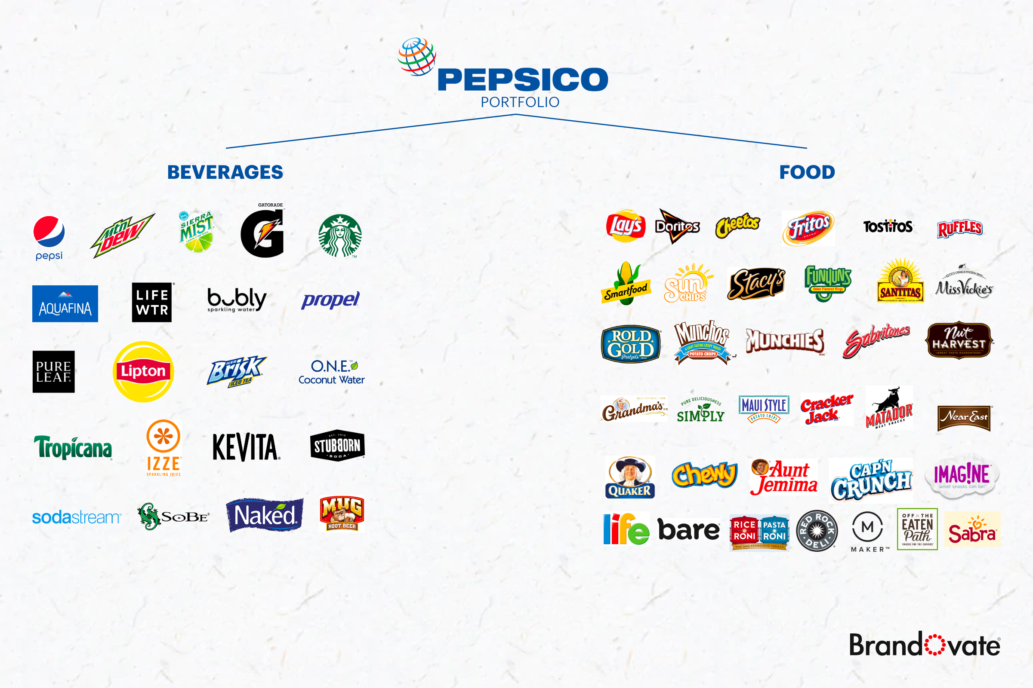
Appendix: Company → Modeling
Team D’accord
Appendix: PEP
1
Diversity Strategy
2
Frequent M&A
Beverage
Food
2011.2: Wimm-Bill-Dann Foods, a Russian food company that produces milk, yogurt, fruit juices, and dairy products
2012.7: Muller Quaker Dairy - PepsiCo's first entry into the dairy space in the U.S.
2016.11: KeVita probiotic drink
2018.5: Bare Foods, fruit and veggie snack maker
2018.8: SodaStream - a strategic plan to steer Pepsi toward offering healthier products
2018.10: Health Warrior, fitness snacks
2018.11: Pipers Crisps, a manufacturer of potato crisps
2018.11: allMotti - PepsiCo's first owned Tech and Computer Service company
2019.2: Cytosport, producer of sports-oriented nutritional products and supplements
2019.2: Muscle Milk, protein supplement products manufacturer
2019.7: Pioneer Foods, multicategory food and beverage company
2019.12: BFY Brands, snacks brand
2020.3: Rockstar
The diverse strategy of PepsiCo products implemented since 2014 is the key factor for PEP to perform well during COVID-19.

Slide 15
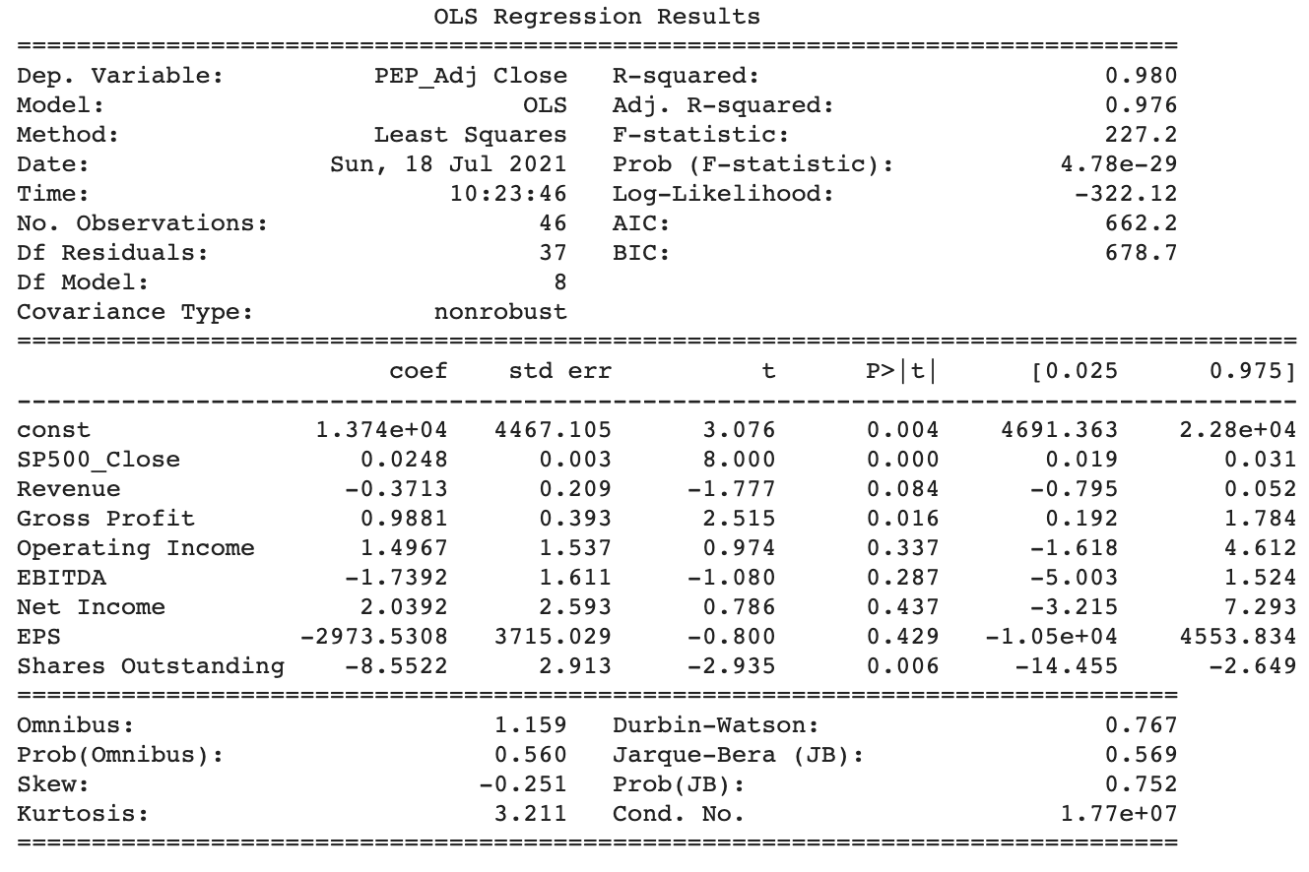
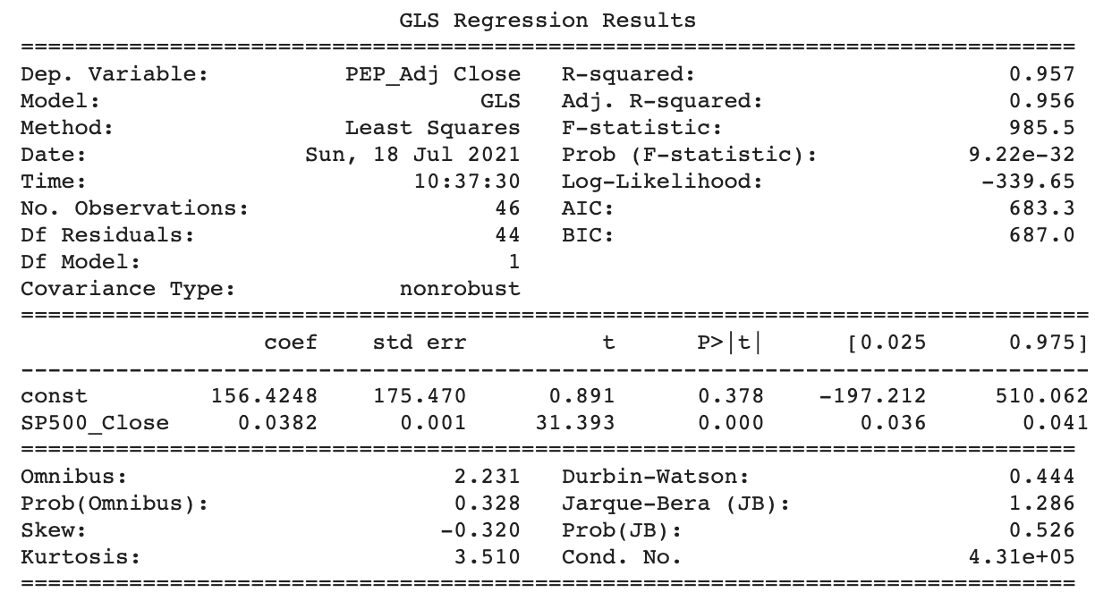
Appendix: Company → Modeling
Team D’accord
Appendix: Feature Selection
Despite of strong predictive power of nueral network, it may be hard to explain the results when with high-dimensional data. To focus more on the explainability, limited features were selected and step-wise regression process was conducted.
1
Stock Market-related Features
2
Financial-related Features
3
Text-related Features
Self-related features: Volume
After cotroling the effect of S&P 500 price, the regression result shows that Gross Profit has the most highly correlated factor to share price, with a positive sign which is consistent with our epectation.
News sentiment
Any information about share price was avoided because it is the result of all exogenous covariate and may eclipse the effect of other features even though it may improve prediction accuracy.
Among historical stock information, only volume is not directly related to price.
Daily news was scraped for the three companies by Selenium package, and process the text by sentiment analysis technique, the dimensions of the output are:
Positve, negative, net positive, anger, anticipation, disgust, fear, joy, sadness, surprise, trust.
Market-related features: S&P 500
Tweets sentiment
During data analysis, share price is found to be highly correlated with S&P 500, with R-square reaches 0.957, though covariance is not robust.
Daily tweets were scraped for the three companies by twint package and twitter api, and process the text by sentiment analysis technique, the dimensions of the output are:
Positve, negative, net positive, anger, anticipation, disgust, fear, joy, sadness, surprise, rust.
Tweets numerical description
Numericla attributes were computed of daiy tweets of one company, the dimensions are:
Number of tweets, at counts, tag counts, number of replies, number of retweets, number of likes.
Although revenue and Net Income is not statistically significant, considering the amount of data for neural network modelling, this two features were also added for carefulness.

Slide 16
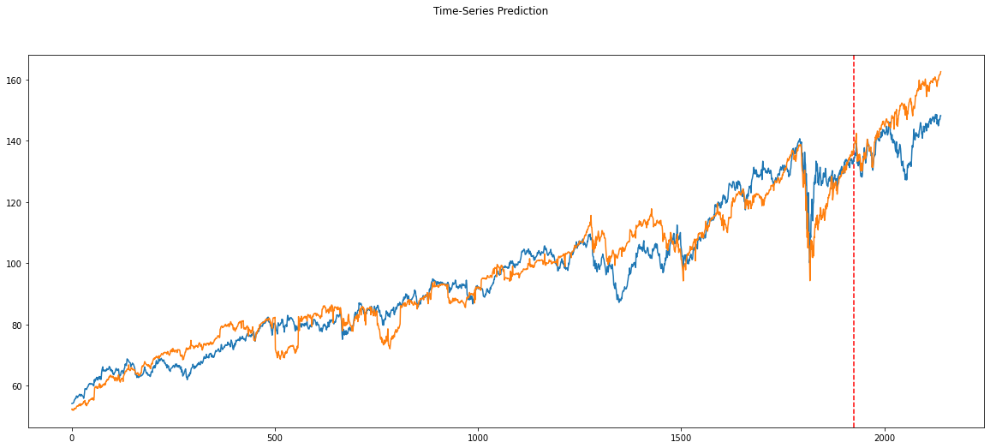
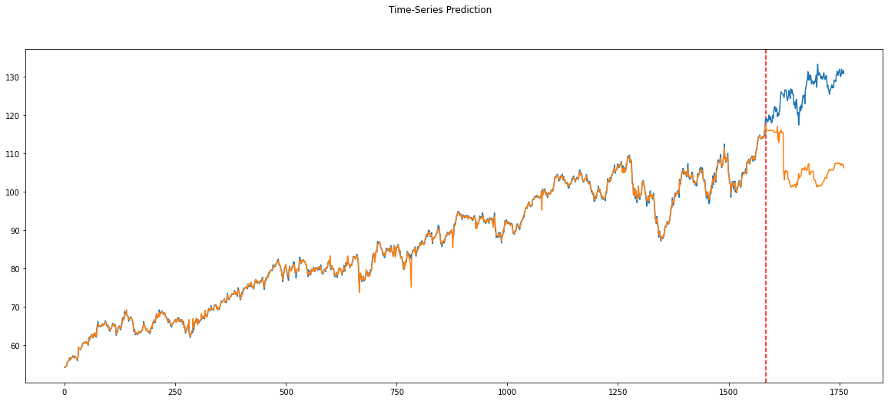
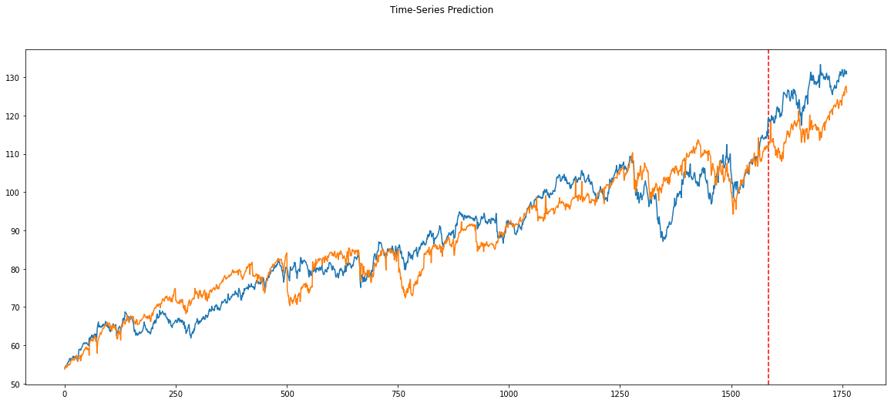
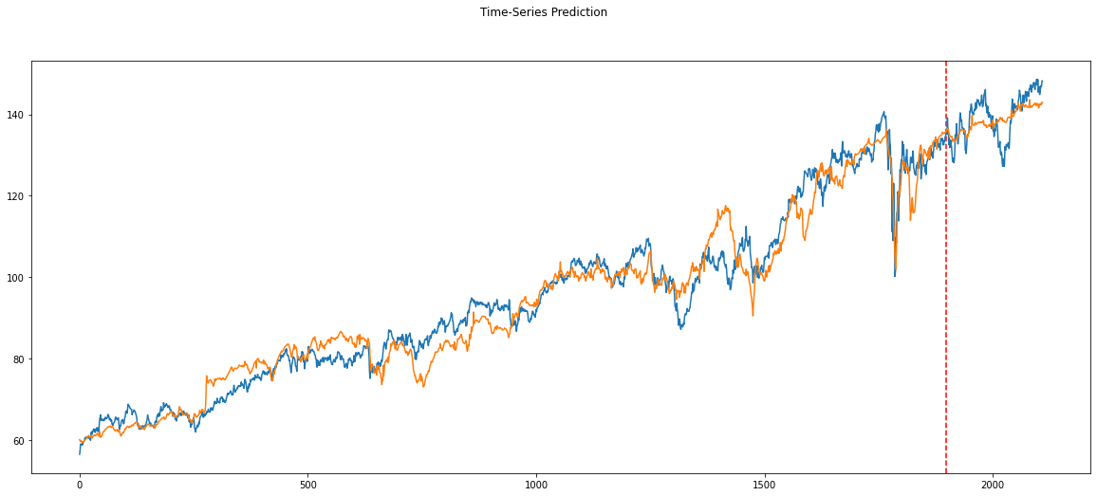
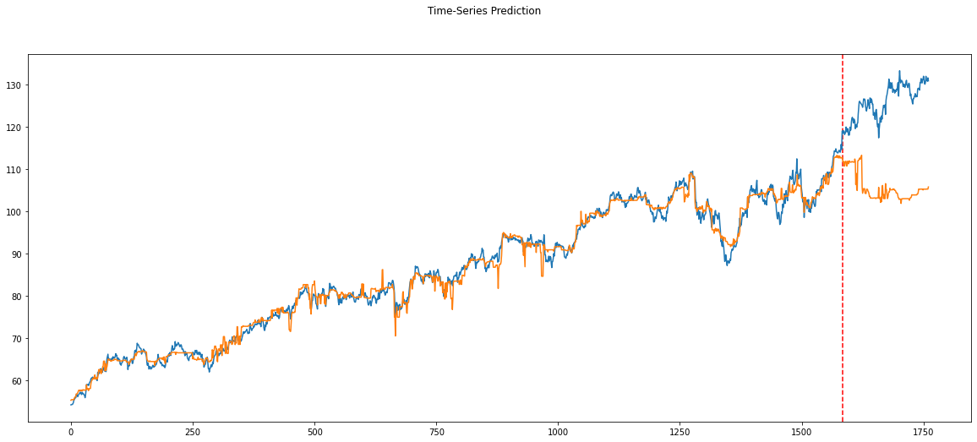
Appendix: Company → Modeling
Team D’accord
Appendix: Model Selection
Model | MSE On all data | R² On all data
Linear Model | 39.4715 | 0.9339
SVM | 29.5397 | 0.9157
XGBoost | 47.8047 | 0.8635
Random Forest | 43.1071 | 0.8769
Neural Network | 21.2276 | 0.9633
Linear
Model
Random
Forest
SVM
Neural
Network
Data set: daily PEP share price from 2013-1 to 2021-7
Train : test = 9 : 1
Features: stock market-related features (hypo1), financial features (hypo2), news sentiment features (partially hypo3)
Best performance model: neural network (the model used for this project)
Through data analysis, share price is highly correlated with S&P 500 and the performance of linear models and tree-based models indicates the relationship between share price and our features is majorly linear and partially non-linear.
XGBoost

Slide 17
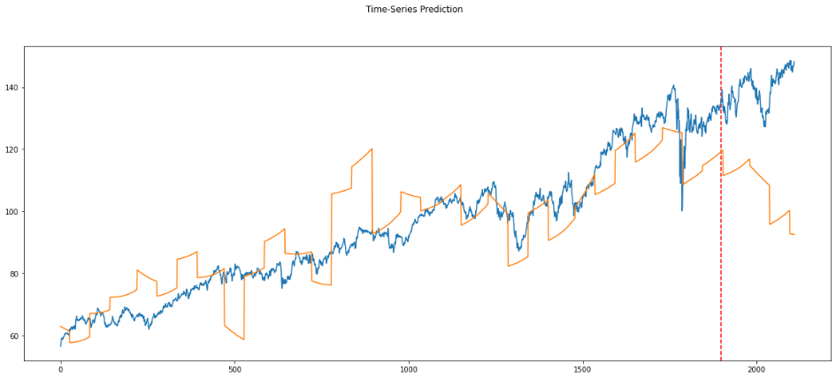
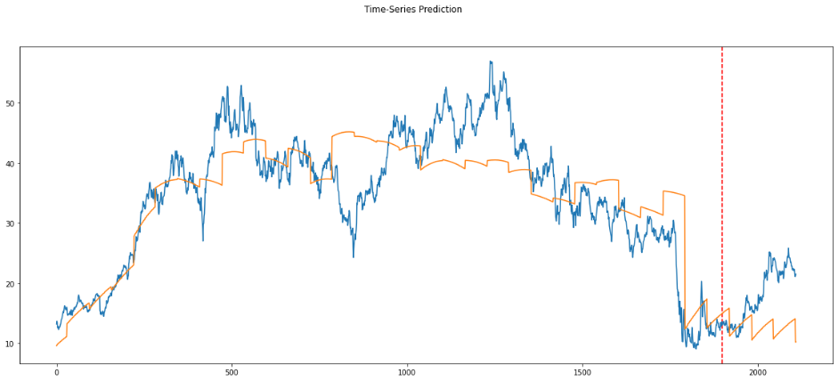
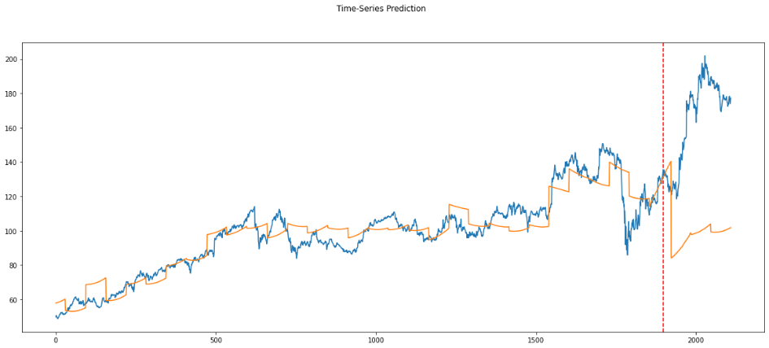
Team D’accord
Appendix: Company → Modeling
Appendix: How to incorporate quarterly data into our model?
One difficulty is to deal with quarterly financial data and put it into daily models. Here is the dilemma:
Daily data should not be aggregated to quarters because the sample scale would be greatly reduced, raising unreliable neural network model.
Financial data is sparse with non-zero value in a few days, so it cannot be treated as features.
We can either:
Use quarterly data and change our model to other tree-based or linear model but we have to discard the power of neural network.
Find a way to transform quarterly data into daily data or at leat incorporate ‘time’ term and let the neural network to learn the hidden pattern.
Second method is selected, and following is data processing steps:
Left join quarterly data to share price data on daily basis,
Pad-fill null entries with its last financial data,
Create a column specify how many days have past since last financial statement was issued and let the neural network to learn the linear / non-linear relationship.
Visualize the learned pattern for each company:
PEP
AAL
DIS

